Slide 1
Fishing Equipment
Wildlife Management

Slide 2
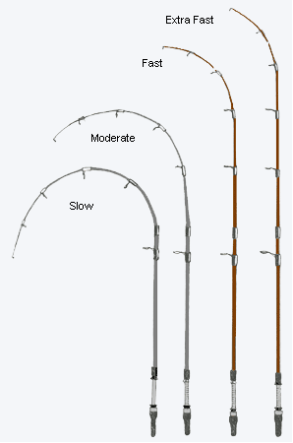
Rods
Video

Slide 3
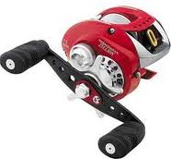
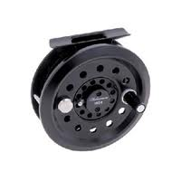
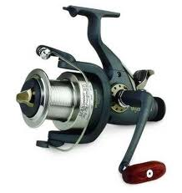
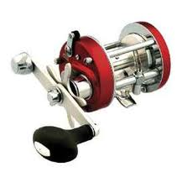
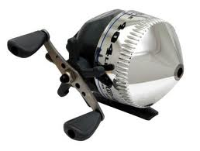
Reels
Fly Reel Baitcast Reel Spin Reel
Spincast Reel Trolling Reel
Video

Slide 4
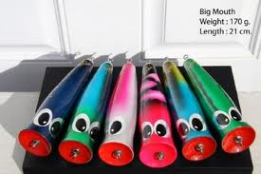
Top-Water Lures
Typically used with large and small mouth bass
Creates a vibrations in water
Color is determined by water and weather conditions
Video

Slide 5
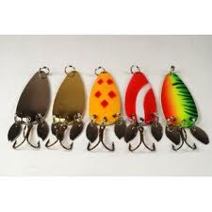
Spoon Lures
Used for most midlevel
feeders.
Creates shine from sun
Spins and creates
vibration
Video

Slide 6
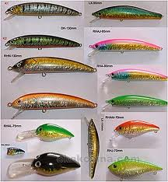
Crankbait Lures
Can be used on any fish
that feed at mid to
deep water
Has sinking and rising
motion
Video

Slide 7
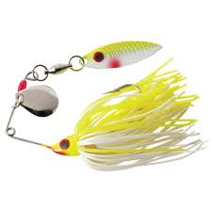
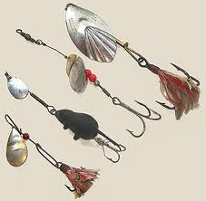
Spinner-Bait Lures
Typically used with Bass
Creates movement
and vibration in the water
Spinner Video

Slide 8
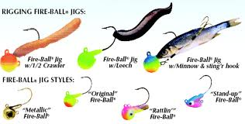
Jig Bait
Used most commonly
with crappie fishing
Allows for fishing in low
movement areas
Video

Slide 9
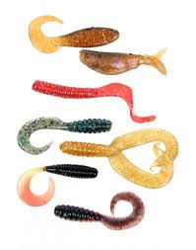
Artificial Bait
Used for all types of Fish
Can be used with
bobber and weight
Diversity of rigging

Slide 10
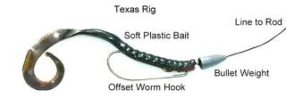
Texas Rig
Video

Slide 11
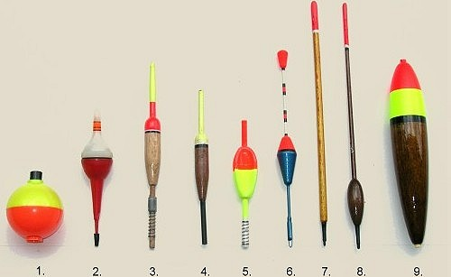
Bobbers
Video

Slide 12
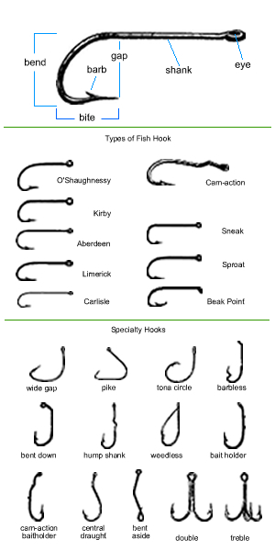
Hooks
Video

Slide 13
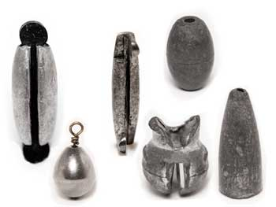
Weights
Video

Slide 14
Spinning Reel Terms

Slide 15
Baitcast Reel Terms

Slide 16
Spincast Reel Terms

Slide 17
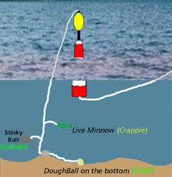
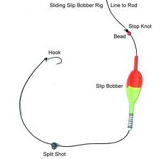
Bobber Rigs

Slide 18
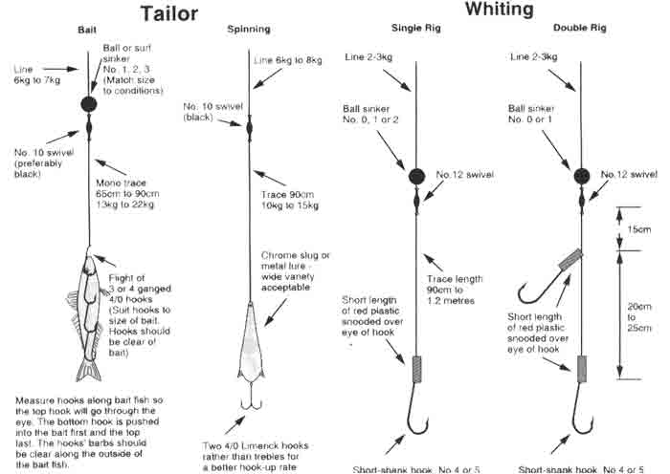
Other Common Fishing Rigs

Slide 19
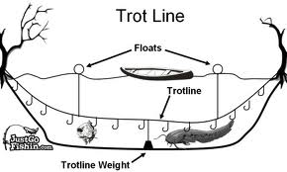
Trot Line

Slide 20
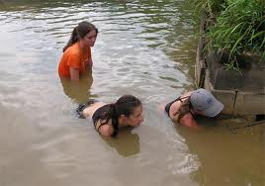
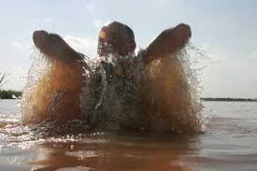
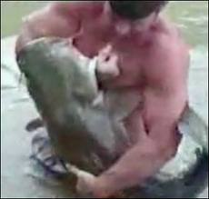
Noodling

Slide 21
https://www.youtube.com/watch?v=Xu65g8ZofJw

Slide 22
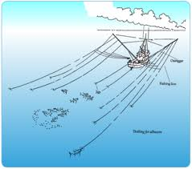
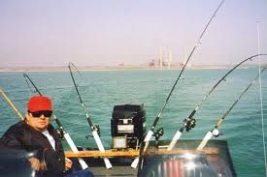
Trolling Fishing

