Slide 1
Safety & Tool ID Exam
Ag Mechanics & Metal Technology

Slide 2
Question # 1
Name
Table Saw
What it does
Cuts straight lines in wood
Safety rules
2 people to use it
3 teeth above
Use push stick if close to fence
Stand to the side of blade
Never have fingers in line with blade

Slide 3
Question # 3
Name
Portable hand drill
What it does
Drill holes in wood or metal
Safety rules
Carry pointed down
Don’t pull trigger unless your using tool
Pull trigger all the way down when using it

Slide 4
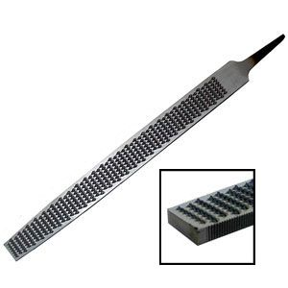
Question #4
Name
Wood Rasp
What it does
Removes a lot of wood when smoothing
Safety rules
Carry pointed down

Slide 5
Question # 5
Name
Circular Saw
What it does
Cuts straight lines in wood
Safety rules
Clamp wood down
Know what is under wood
Watch chord
Start machine with blade not touching wood

Slide 6
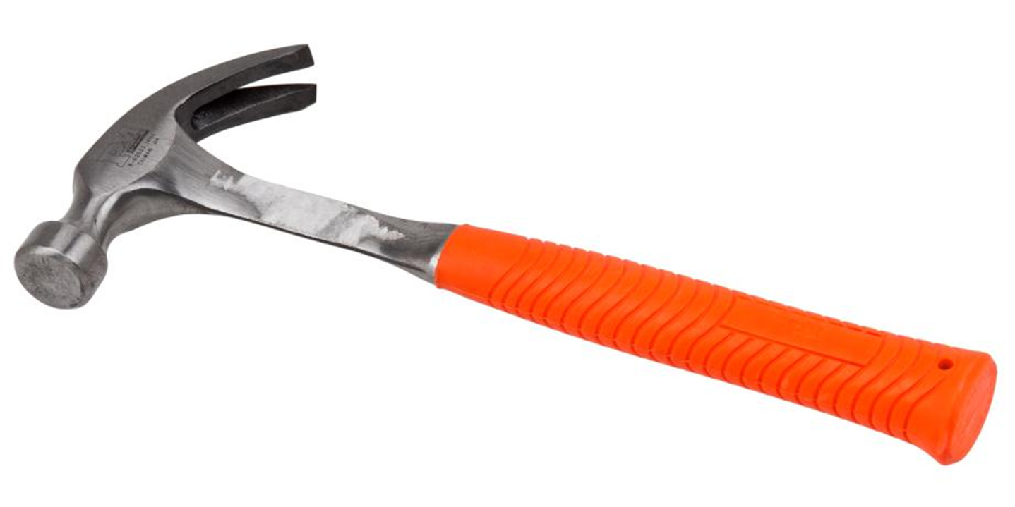
Question # 6
Name
Claw Hammer
What it does
Drives and removes nails
Safety rules
Don’t swing above head
Don’t hit against another hammer

Slide 7
Question # 7
Name
Drill Press
What it does
Drills holes in wood or metal
Safety rules
No loose clothing/hair tied back/etc
Chuck must be in its home
Clamp material down
Keep piece of scrap wood below what you are drilling

Slide 8
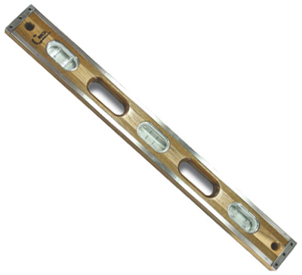
Question # 8
Name
Level
What it does
Checks to see if things are level (parallel with ground) or straight up and down

Slide 9
Question # 9
Name
Miter Saw
What it does
Cuts angles in wood
Safety rules
Watch your thumb
Keep wood against fence
When pulling the trigger hold till blade is all the way down and back up before releasing
Keep finger off trigger until ready to use
Don’t cross arms

Slide 10
Question # 10
Name
Speed Square
What it does
Measures angles and makes drawing 90 and 45 degree angles easy

Slide 11
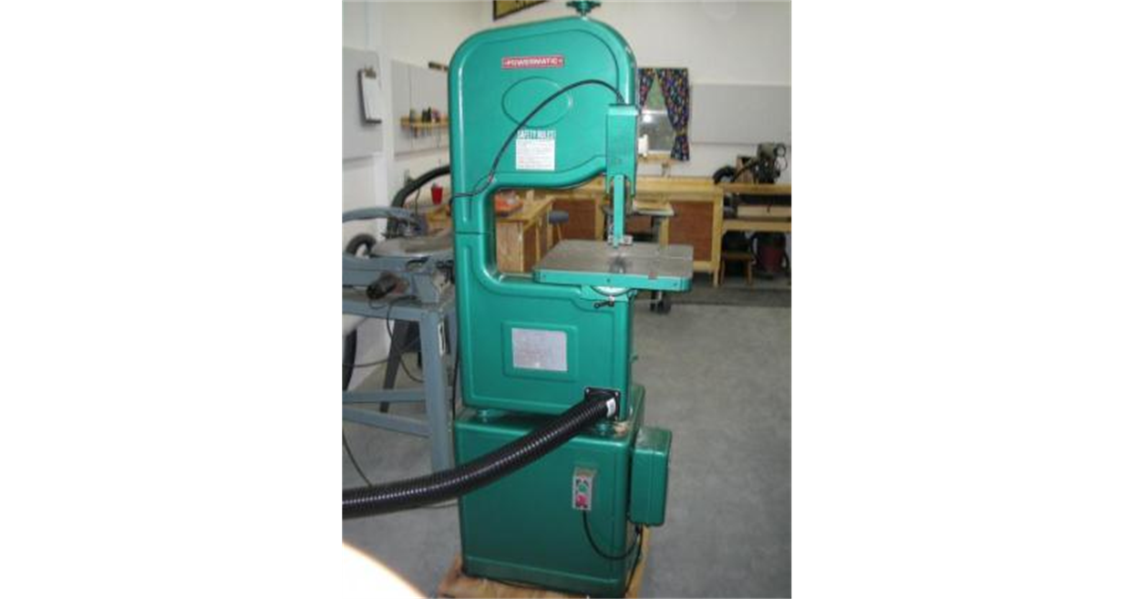
Question # 11
Name
Band Saw
What it does
Cuts curved lines in wood
Safety rules
Don’t cut cylindrical/round material
Fingers should not be in line with blade
Clear scrap with piece of wood
Never make adjustments inside machine while it’s plugged in
If you hear a pop turn machine off and grab Molina

Slide 12
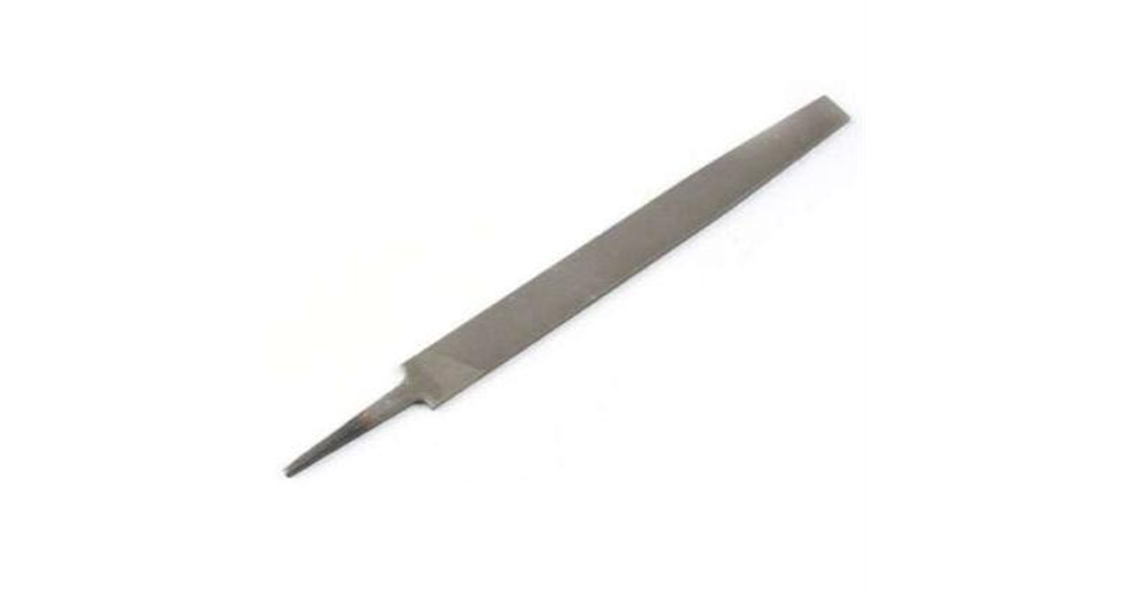
Question # 13
What it is
Metal File
What it does
Smoothes Metal
Safety Rule
Carry pointed down

Slide 13
Question # 14
Name
Vise Grip
What it does
Holds hot metal securely

Slide 14
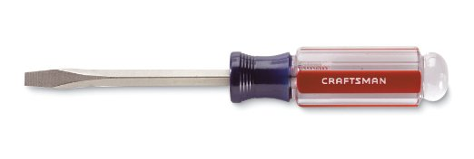
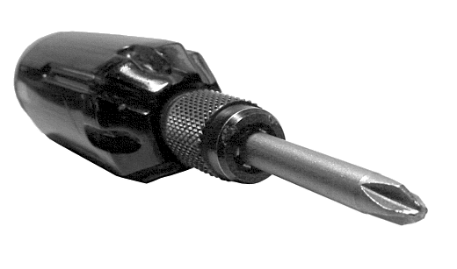
Question #15
15a*
Flathead screwdriver
15b*
Phillips Head Screwdriver
Carry both pointed down

Slide 15
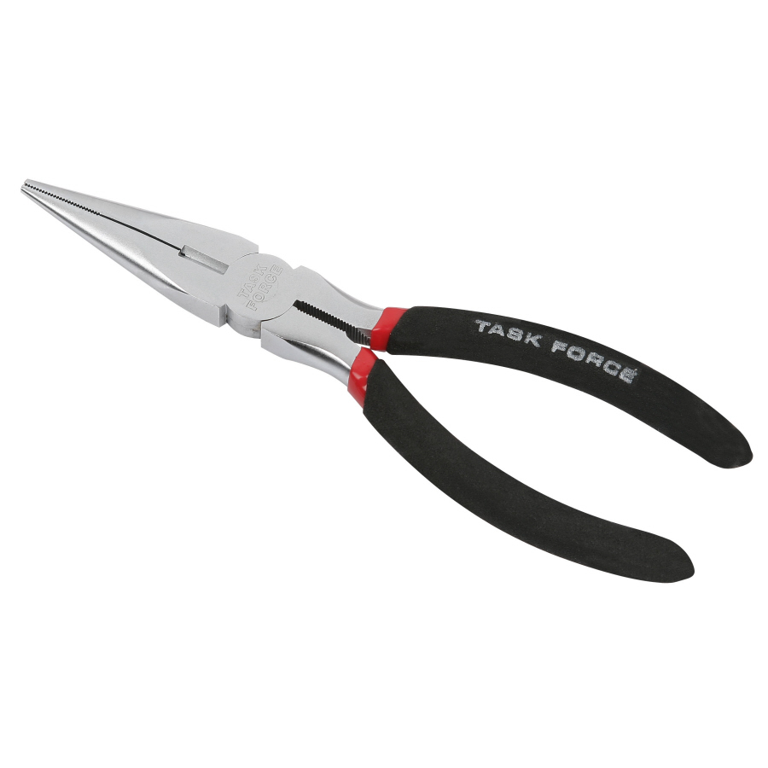
Question # 17
What it is
Needle Nose Pliers

Slide 16
Name
Channel Locks
What it does
Helps Tighten and Loosen

Slide 17
Name
Ratchet and Socket
What it does
Helps Tighten and Loosen nuts and bolts

Slide 18
Name
Chipping (slag) hammer
What it does
Used during stick welding to remove slag

Slide 19
Name
Wrench
What it does
Helps Tighten and Loosen nuts and bolts

Slide 20
Name
Vise
What it does
Holds things securely (usually metal)
Safety rules
Don’t over tighten
Make sure to close when done using

Slide 21
Name
Drill Bits (individually)
Drill Bit Index (the whole box)
What it does
Drills holes in different materials

Slide 22
Name
Ball Peen Hammer
What it does
Hammers everything but nails
Safety rules
Don’t swing above head
Don’t hit against another hammer or hardened material

